Slide 1
Detecting Suspicious Behavior with Deep Learning
Presenters:
Anif Zarus Andrew Thomas
Khamalesh Ramesh
Prashanth Kumar

Slide 2
Agenda of the presentation
Project Overview
Methodology
Data Understanding and Preprocessing
Modelling
Evaluation
Conclusion & Future Works

Slide 3
Project Overview
This project uses Deep Learning and Computer Vision to detect suspicious behavior using unstructured data like images and videos. We use the UCF Crime dataset and focus on identifying odd behaviours like shoplifting, vandalism, burglary, and normal behavior. The goal is to train multiple models to recognize these actions accurately and evaluate the best model amongst them.

Slide 4
CRISP-DM Framework Overview
Business Understanding
The business understanding focuses on the objectives of our project which are as follows
To Identify suspicious behavior that could potentially lead to shoplifting, vandalism or burglary
By achieving the objective, we can
Reduce financial losses due to shoplifting, burglary and vandalism
Provide a safe environment for the customers

Slide 5
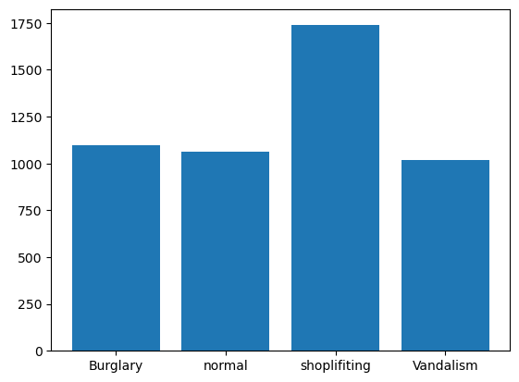
Data Understanding And Preprocessing
Class | Images per Class | File format | Pixels
Shoplifting | 1738 | PNG | 64 * 64
Burglary | 1099 | PNG | 64 * 64
Vandalism | 1020 | PNG | 64 * 64
Normal | 1061 | PNG | 64 * 64

Slide 6
Data Cleaning & Preprocessing: Steps were taken to clean and prepare the data, ensuring it was suitable for model training.
Image Selection Constraints: Due to limited computing power, only a subset of the dataset was used for training.
Image Resizing: Original images (64×64) were resized to 224×224 to improve model performance, though this reduced the training data size.
Quality Checks: Images were selected based on clarity, focus, brightness, and absence of corruption to ensure useful input for behavior detection.
Data Storage: Preprocessed data was saved as NumPy arrays to avoid repeating preprocessing steps during training.

Slide 7
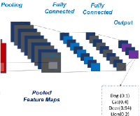
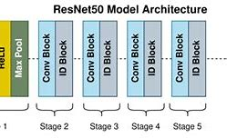
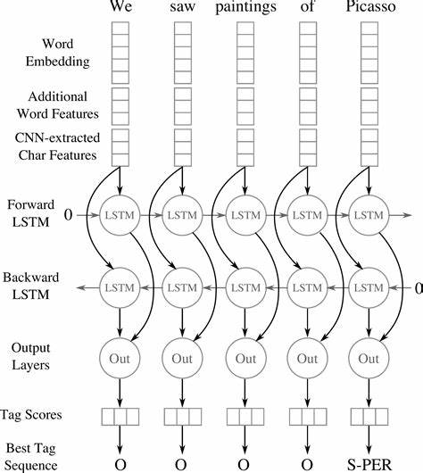
Overview of Model Architectures
Custom CNN Architecture
It has been built with 3 hidden layers
Feature layers: Conv2D, MaxPooling, Dropout, and Dense. Utilized Adam optimizer with learning rate 0.001.
ResNet50 Model
Utilized pre-trained weights with fine-tuning for enhancing the performance.
CNN-BiLSTM Integration
CNN extracts spatial features while BiLSTM captures temporal dependencies for improved analysis.

Slide 8
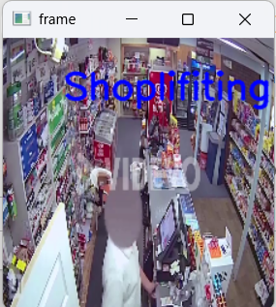
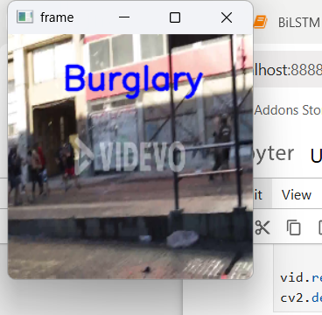
Performance Metrics Comparison
Model Evaluation | CNN | ResNET50 | CNN+BiLSTM
Accuracy | 0.9787 | 0.9429 | 0.9982
Loss | 0.2806 | 0.2483 | 0.0012
Value Accuracy | 0.9980 | 0.9268 | 0.8415
Value Loss | 0.2210 | 0.2270 | 0.5008
Epochs | 10 | 2 | 3
Precision | 0.9987 | 0.9982 | 1.0
Recall | 0.9998 | 0.8822 | 0.9995
F1 score | 0.9987 | 0.9319 | 0.9998

Slide 9
Conclusion and Future Work
CNN-BiLSTM Performance: The CNN-BiLSTM model delivers high accuracy but requires significant computational resources.
ResNet50 Advantages: ResNet50 provides a good trade-off between speed and accuracy, making it suitable for a variety of use cases.
Edge Device Deployment: Future work involves deploying models on edge devices to support real-time behavior detection.
3D CNN Exploration: Investigating 3D CNNs can improve the analysis of both spatial and temporal features in video data.
Model Optimization: Optimizing models for performance and resource efficiency remains a key focus for broader deployment.

